Slide 1

Institutional Predictors of First-Year Student Retention in U.S. Higher Education
Keith Willson
Notes:
1. Cover in your presentation each of the following points:
• brief introduction of yourself and your background
• statement of the problem and the hypothesis
• summary of the data-analysis process
• outline of the findings
• explanation of the limitations of the techniques and tools used
• summary of proposed actions
• expected benefits of the study (be as specific and quantitative as possible)

Slide 2
Keith Willson
Bachelors of Arts, Psychology
  UC Merced Class of 2015
  Psychology and Cognitive Science Researcher
Pursuing M.S. Data Analytics: Decision Process Engineering
  Western Governors University
Admissions Director
  Hilldale School in Daly City, CA

Slide 3
What’s the deal with student retention?
Why does student retention matter?
Retention is the percentage of first-year students who continue on to their second year at a given university.
Average retention rates in the United States in 2024:
  Full-time students: 76.2%
  Part-time students: 47%
Lost potential revenue from the next three year’s tuition
Attrition lowers return on investment from money spent on recruitment
Low retention hampers recruitment
Students waste money on a year’s worth of tuition
Government budgets for college expenses through Pell grant

Slide 4
What drives retention?
Purpose of this analysis
Known student-based factors
GPA
On-campus housing status
Sense of belonging
Institutional social responsibility
Student loyalty
Known institutional factors
Selectivity
Governance structure
  For-profit, non-profit, religious, etc.
To provide institutions with information to actively improve their retention outcomes
To develop two regression models that identify significant institutional predictors of retention for part-time and full-time students
H₀: There are no institutional factors that significantly influence retention
H_{a}: There are one or more institutional factors that significantly influence retention

Slide 5
How do we analyze retention?
Data provided by Integrated Postsecondary Education Data System (IPEDS), hosted by National Center for Education Statistics (NCES)
  Annual survey data from every postsecondary U.S. institution that participates in federal student financial aid programs
  23-24 school year, most recent data publicly available
Variables most relevant to institutions hand-picked from datasets, cleaned, prepared, and standardized in Python
Ordinary Least Squares regression model created in Python, finding the best-fit line by minimizing sum of squared differences between predicted and actual retention rates

Slide 6
How do we analyze retention?
Models refined until most robust model found
  Variables removed due to collinearity with other variables or lack of significance
    p-values < .10 accepted for these models to emphasize identification of predictors over predictive accuracy
R² and Root-Mean-Squared Error (RMSE) calculated to evaluate model accuracy

Slide 7
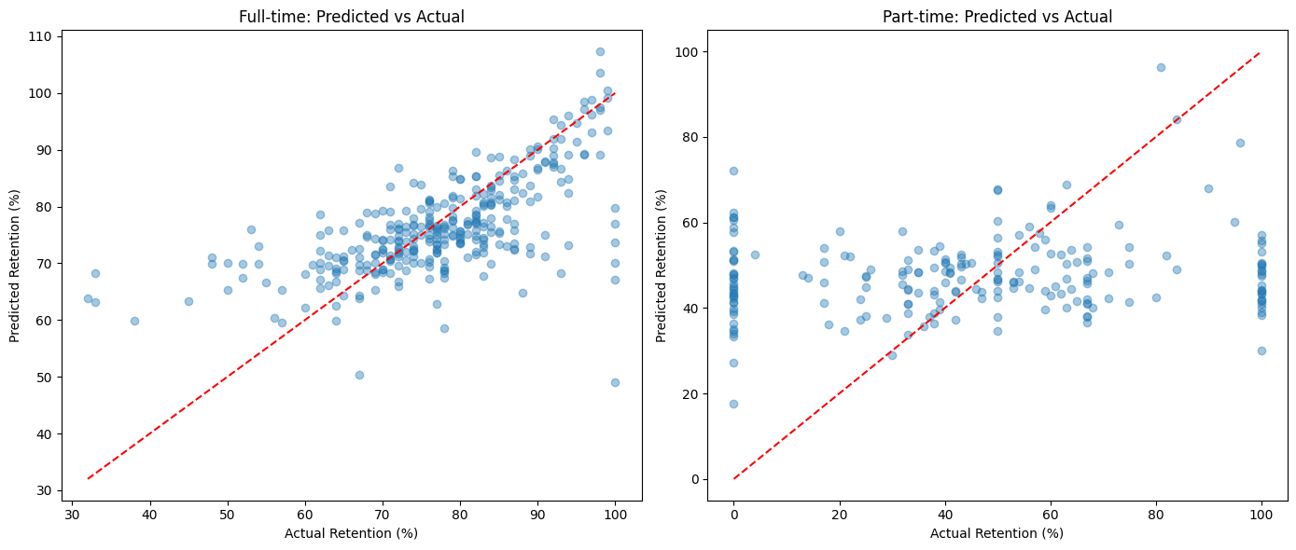
How accurate are the models?
Full-time R²: 0.413 - the model explains roughly 42% of retention variance
Full-time RMSE: 9.153 - average prediction will be off by about 9%
  Good accuracy for a social science model
Part-time R²: -0.001 - the model fails to explain any retention variance
Part-time RMSE: 31.483 - average prediction will be off by about 31%

Slide 8
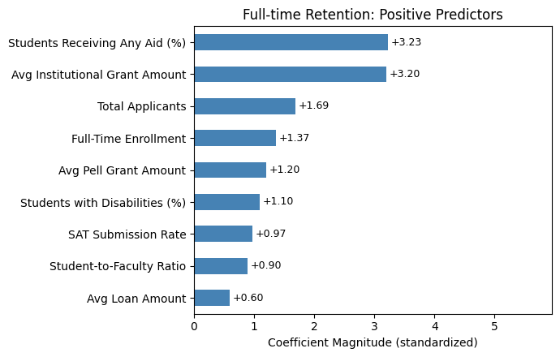
What drives UP retention for full-time students?
Accepting college-ready students
Higher retention among schools with higher SAT submission rate likely speaks to the kinds of students being accepted.
Students submitting SAT scores more likely to be on a college preparatory path
Consistent with previous GPA finding

Slide 9
What drives UP retention for full-time students?
Being a larger school
More diverse course offerings
More social infrastructure
Name recognition
Prestige
Age - more time to build population, prestige, and resources
Having more full-time students, more likely to stay than part-time students

Slide 10
What drives UP retention for full-time students?
Having more resources
Likely not “having more students with disabilities = higher retention.”
Likely is about schools with resources to accommodate students with disabilities
% Students with disabilities correlates with higher tuition, institutional grant avg (r = ~0.5)
Minor correlation with study abroad programs and undergrad research opportunities = better return-on-investment for students

Slide 11
What drives UP retention for full-time students?
Giving students more money
Providing students with the means to afford college is the biggest positive contributor to retention
Higher institutional grant amounts = higher retention
  Note: institutional grant avg highly correlates with tuition price (r = .93).
Higher Pell grant amounts and loan amounts also drive up retention to a lesser extent

Slide 12
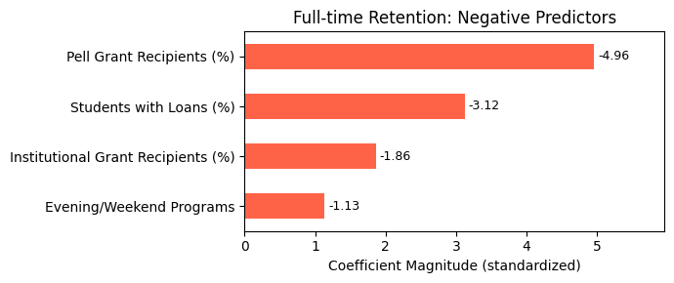
What drives DOWN retention for full-time students?
More students needing money
Higher percentages of students requiring government aid and loans drives down retention.
  The most impactful predictors in the entire model
More students given institutional grants also drives it down to a lesser extent
  Free money vs. need to pay back
In short: more financially unstable students ruins retention

Slide 13
What drives DOWN retention for full-time students?
Evening/weekend Programs
Modest effect, relatively low significance only accepted with relaxed threshold (p = .075).
Possibly signals colleges offering courses to accommodate full-time students who can’t attend during day and are stretched thin.

Slide 14
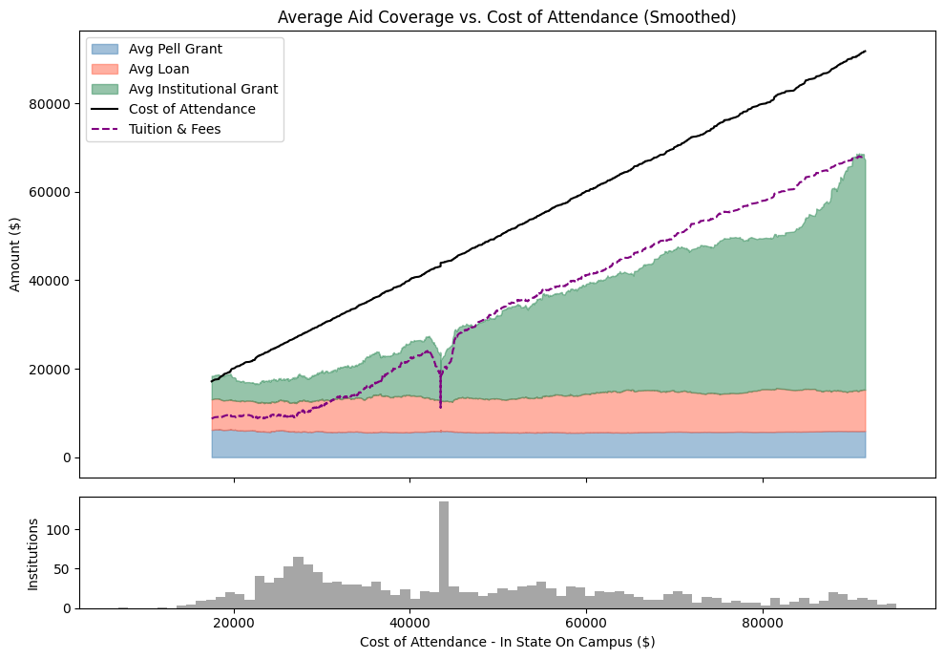
Interaction between positive and negative
Giving institutional grants allows affordability for students. Spreading grants too thin limits their effect
  Not easy to address:
    Average public college already spend more per student than average tuition,
    Can’t restrict accessibility
% of students receiving aid is positive, but % of student receiving specific kinds of aid is negative to a greater degree
  Grants usually only assist up to tuition price without accounting for cost of living, which makes up a large portion of cost of attendance

Slide 15
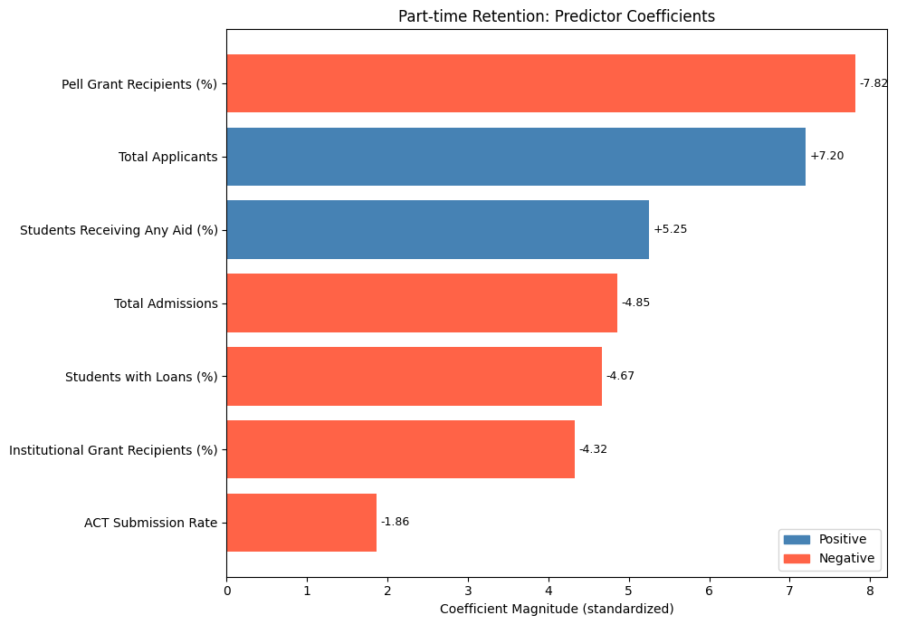
What affects retention for part-time students?
Take this with a grain of salt
Part-time model was unable to accurately predict retention
Part-time retention can’t be predicted with the institutional variables used in this analysis
  Either a more student-focused phenomenon or something else outside the realm of this analysis
Nevertheless, variables identified were found to significantly correlate with part-time retention rates

Slide 16
What affects retention for part-time students?
Different dynamic from full-time
Total admissions: colleges with more part-time students see lower retention.
  Consistent with lower average retention rate for part-time students
ACT Submission rate: negative predictor of part-time retention
  Might be noise, only accepted with relaxed p-threshold
  (p = .067)
  Hard to explain. SAT submissions were positive for full-time

Slide 17
Limitations of this analysis
Regression models reveal association, not causation
  Cannot guarantee outcomes
  Complicated phenomenon driven by economy, marketing etc.
“Chicken-and-egg” problem:
  Do schools have better retention because they have more resources, or do they have more resources because they have higher retention?
Correlated variables are dropped from the model
  Tuition price and institutional grant average are highly correlated. If institutional grant average was omitted, tuition would likely take its place, possibly altering the framing
Relies on what data IPEDS provides, and can’t account for external factors
  23-24 data, may still be impacted by COVID.

Slide 18
So what can this analysis tell us?
The institutional factors used for this analysis can partly explain changes in retention for full-time students, but not part-time students
Money Talks: The most impactful predictors for retention were financial-related variables
Despite being a major expense, institutional grants are doing their job of allowing students to stay at university when given enough $$$.
  The Pell grant helps, but is largely insufficient. More government support could help relieve retention issues
Well-resourced schools are in a better position for retention. Smaller schools with fewer resources may struggle

Slide 19
Which variables don’t drive retention?
Disclaimer: just because they didn’t make it into the model, doesn’t mean they should be disregarded as important factors.
Nevertheless, notable variables that didn’t prove significant:
  Governance structure - previous findings included for-profit, but among nonprofits, governance makes little difference
  Religious vs. Non-religious
  Cost of attendance & tuition - collinear with institutional grant average, less statistically significant
    Implies what institutions do to offset cost might be more important than cost itself

Slide 20
Where to go from here?
Expected benefits of this study: limited.
  More research required to properly explain institutional factors explaining retention
    Part-time retention will require a different set of variables entirely
  Capture data over time instead of 23-24 snapshot.
  Incorporate cost of attendance for out-of-state students — was originally removed but later found to improve model performance

Slide 21
References
Albornoz-Toyohama, R. H., Mendigure-Hachircana, R., Haro-Casildo, S., & Abanto-Ramírez, C. D. (2025).
Factors influencing student retention university students: an analysis of institutional reputation, social responsibility and loyalty.
https://doi.org/10.3389/feduc.2025.1499518
Hanson, M. (2026, February 17).
U.S. public education spending statistics.
https://educationdata.org/public-education-spending-statistics
Muller, K., Feuer, E., Nyman, M., Sokolowski, K., Squadere, J., & Rotella, L. (2017).
Examining predictors of first year college student retention. New York Journal of Student Affairs, 17(1), 3–14.
https://commons.library.stonybrook.edu/cgi/viewcontent.cgi?article=1017&context=nyjsa
National Center for Education Statistics. (2022).
Undergraduate retention and graduation rates.
https://nces.ed.gov/programs/coe/indicator/ctr
National Student Clearinghouse Research Center. (2025, June 26).
Persistence and retention: Fall 2023 beginning postsecondary student cohort.
https://nscresearchcenter.org/persistence-retention/

